Slide 1
Matrix Multiplication using OpenMPI
Group Member:
Yasir Nawaz (P20-0557)
Sharjeel Hussain (P20-0150)
1

Slide 2
Content
Definition
Advantages of using OpenMPI
Setup
General MPI Program Structure
Basics of MPI
Comparison between Serial And MPI
Conclusion
2

Slide 3
Definition
Message Passing Interface (MPI)
A means of machine communication
MPI is commonly used in high-performance computing applications to enable efficient parallel processing on large-scale computer clusters.
It provides a set of functions for sending and receiving messages between different processes, as well as for managing data distribution and synchronization.
3

Slide 4
Advantages of using OpenMPI
Portability: OpenMPI can run on various platforms, including multi-core processors and clusters
Scalability: OpenMPI is designed to scale efficiently from a few cores to thousands of processors, enabling high-performance computing applications to harness the power of large-scale parallel systems.
Performance: OpenMPI provides optimized communication algorithms and protocols, such as point-to-point communication. It uses load balancing concepts in terms of processors.
3

Slide 5
Setup and Installation
Installation:
Ubuntu:
sudo apt-get install openmpi-bin libopenmpi-dev
MacOS:
brew install openmpi
pip install mpi4py
Compile & Run:
Python:
mpiexec –n <number of processes> python file_name.py
C:
Compile: mpicc –o program program.c
Run: mpirun –n <no. of processes> ./program
3

Slide 6
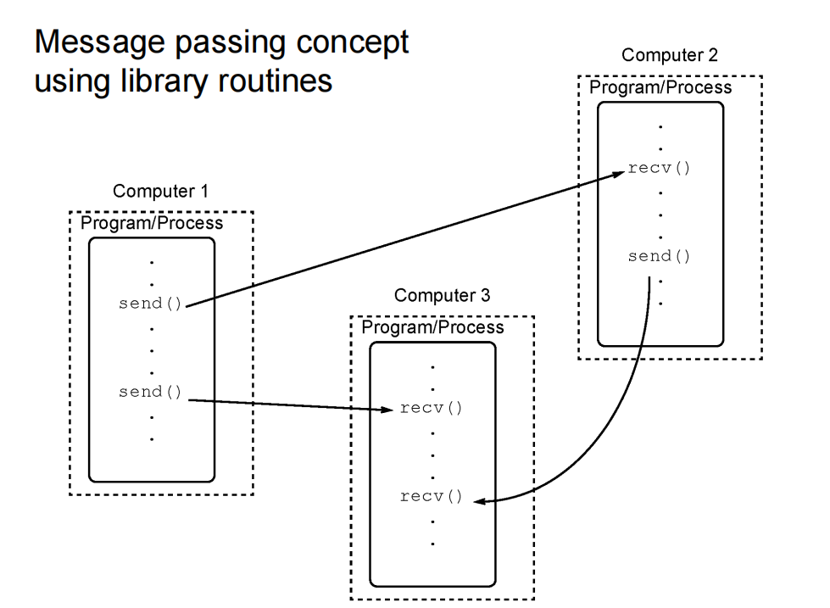
3

Slide 7
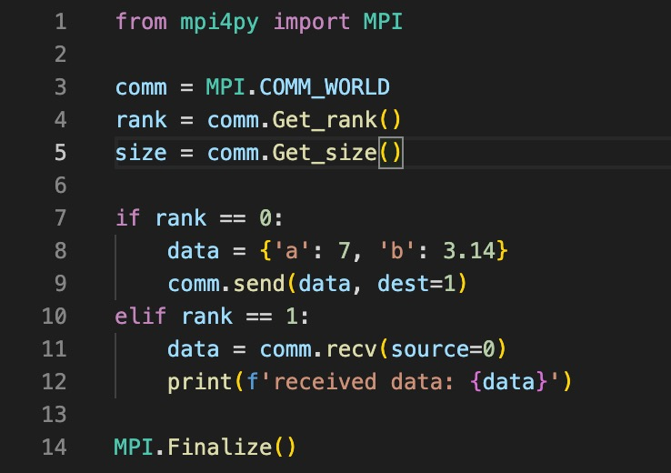
General MPI Program Structure
7

Slide 8
Basics of MPI
# Initialize MPI environment
comm = MPI.COMM_WORLD
rank = comm.Get_rank()
size = comm.Get_size()
#Message Passing
MPI_send()
MPI_recv
7

Slide 9
Basics of MPI
# Finalize MPI environment
MPI.Finalize()
#exchange data between processes in a communicator
comm.Scatter()
comm.Gather()
comm.Bcast
9

Slide 10
Comparison Between Serial And Parallel Matrix Multiplication (MPI)
CODE
10

Slide 11
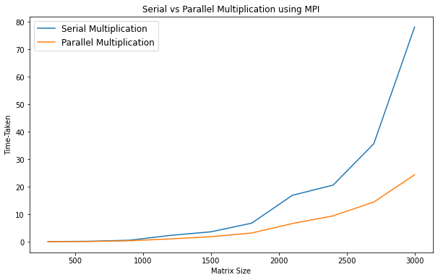
Comparison Between Serial And Parallel Matrix Multiplication (MPI)
11

Slide 12
Speed up
Matrix Size | Time Taken by Serial Multiplication | Time Taken by Parallel Multiplication | Speed Up
300 | 0.021503 s | 0.00430298 s | 4.99723x
600 | 0.137226 s | 0.0465689 s | 2.94673x
900 | 0.510588 s | 0.31838 s | 1.60371x
1200 | 2.27023 s | 0.994739 s | 2.28224x
1500 | 3.58011 s | 1.80924 s | 1.97879x
1800 | 6.73403 s | 3.14155 s | 2.14354x
2100 | 16.8736 s | 6.60424 s | 2.55497x
2400 | 20.6095 s | 9.38929 s | 2.195x
2700 | 35.6896 s | 14.4348 s | 2.47247x
3000 | 78.1609 s | 24.3583 s | 3.20879x
12

Slide 13
Conclusion
In this project, we implemented parallel matrix multiplication using MPI, and compared its performance with a serial implementation. We found that parallelization can significantly speed up matrix multiplication for large matrices, but may not be worth the overhead for smaller matrices. The choice between serial and parallel implementation depends on the size of the matrices and the available computing resources.
<number>

Slide 14
Have a nice day

